Slide 1
Project Magma Prototype
Dominik Käser
Christian Oberholzer
Janick Bernet

Slide 2
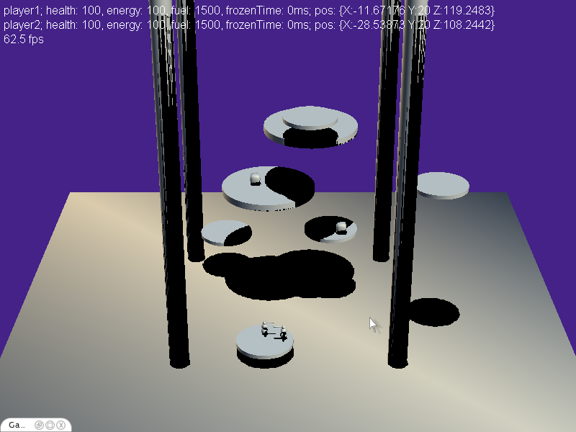
Prototype Elements
Lava
Pillars
Moving Islands
Powerups

Slide 3
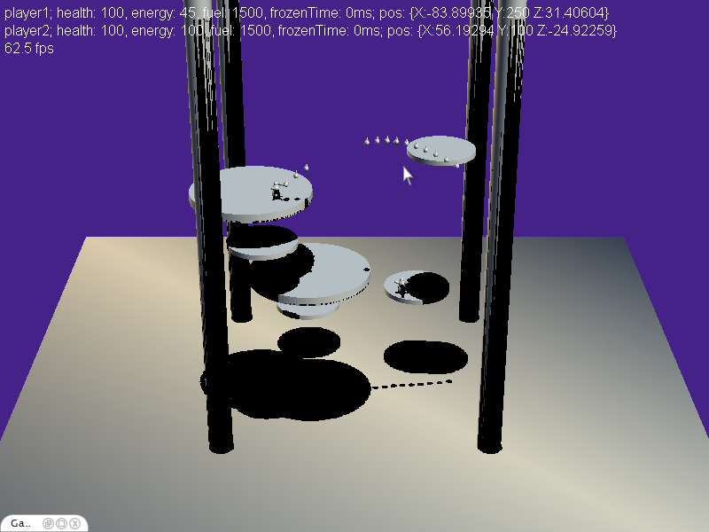
Prototype Interactions
Ice spike
Jetpack
Hit & pushback
Sound

Slide 4
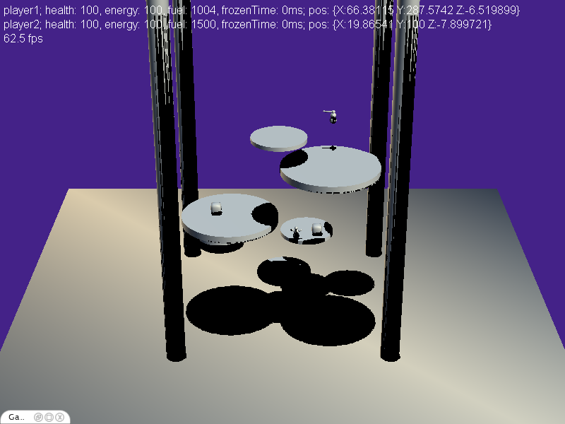
Prototype Insights
Positioning
Add shadows
Player contours
Camera (angle, focal length)
Inter-Island movement
More passive approach (island selection)
Other means of movement (hook, island attraction)

Slide 5
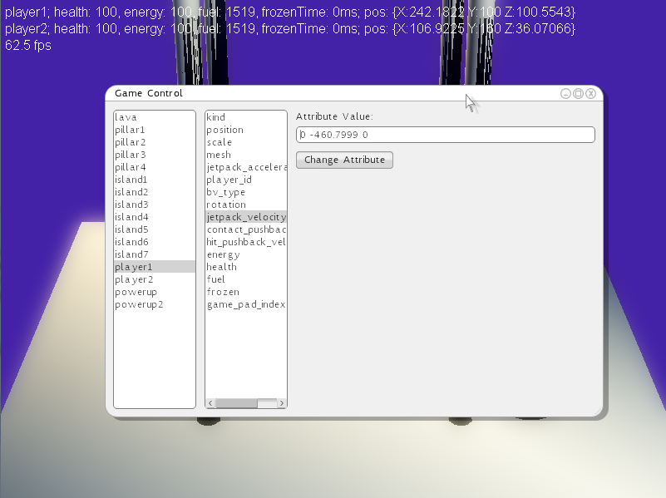
Prototype Insights
Intra-Island movement
Don’t fall from island
Parameter tuning

